Slide 1
CUSTOMER CHURN ANALYSIS

Slide 2
Topic
WHAT IS CUSTOMER CHURN ANALYSIS
IMPORTANCE OF CUSTOMER CHURN ANALYSIS
MATHAMETICAL APPROACH
DATA SET
IMPLEMENTATION
FLOW DIAGRAM
CONCLUSION
FUTURE ENHANCEMENT

Slide 3

What is customer churn analysis
The customer churn analysis feature helps us identify and focus on higher value customers, determine what actions typically precede a lost customer or sale, and better understand what factors influence customer spending. When you improve customer retention, you substantially improve the bottom line.

Slide 4

Keeping an existing customer is much cheaper than acquiring a new customer.
Retaining customers is one of the most critical challenges in the maturing mobile telecommunications service industry.
The cost of keeping an existing customer is at least 5 times cheaper than the cost of acquisition of a new customer.

Slide 5
NAIVE BAYES CLASSIFICATION
First Step : Calculate the Class Probabilities
Second step : Calculate the Conditional Probabilities
Third step : Calculation of the likelihood
Forth step: estimated value calculated from the likelihood
Fifth step : putting of bayes theorem .
MATHEMETICAL APPROACH

Slide 6
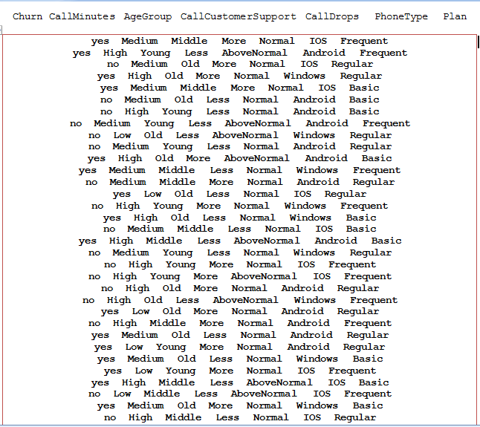
DATA SET

Slide 7
Implementation
WE HAVE USED HADOOP FRAMEWORK FOR THE IMPLEMENTATION OF THE ENTIRE PROJECT
IMPLEMENTAION OF MAPPER,CUSTOM KEY,REDUCER CLASS FOR CALCULATION OF THE CONDITIONAL PROBABILITY.
ANOTHER CLASS FILE HAS BEEN CREATED FOR THE CALCULATION OF THE PROBABILITIES OF THE TRAINING SET’S DATA.
FINAL MAPPER CLASS CREATION FOR THE CALCULATION OF THE LIKELIHOOD AND BAYES THEOREM IMPLEMENTATION FOR FINDING OUT THE CHURNING PROBABILTY ON THE TESTING DATA SET.

Slide 8
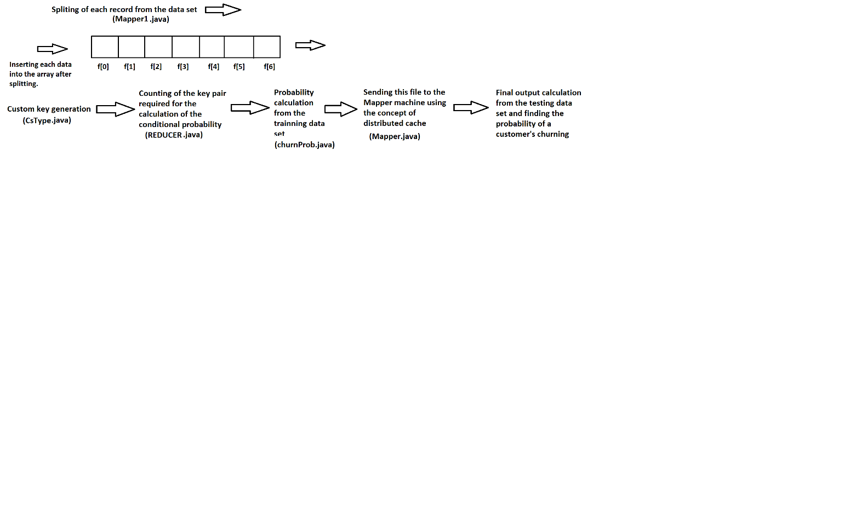
Flow diagram of the program

Slide 9

In the context of big customer behavior data, a customer churn prediction based on customer segmentation and misclassification cost is developed. The proposed model conducts customer segmentation first, which is of benefit for model to enhance its ability of churn customer recognition as well as facilitating companies to develop customer maintain strategy. Then, we make customer churn prediction with classification cost based on different customer groups.

Slide 10
Future enhancements
THE EFFICIENCY THAT WE HAVE GOT AFTER THE CALCULATION IS ALMOST 62.3%
WHICH CAN BE ENHANCED USING SOME DEVELOPED FORMULA AND FURTHER
CALCULATION,SO THAT IT WILL BE EASIER FOR US TO CALCULATE THE CHURN
PROBABILITY OF A CUSTOMER,WHICH WILL PROVIDE BETTER STABILITY AND
BETTER FLEXIBILITY.

Slide 11
ThanK YOU

